Slide 1

Building Online Experiments
Tasfia Ahsan
November 21, 2025

Slide 2

In-Person Experiment
Building
Hosting
Consent
Recruitment
MATLAB
PsychoPy
In a lab setting
Physical consent form
URPP

Slide 3
Online Experiment
Building
Hosting
Consent
Recruitment
PsychoPy
jsPsych
Gorilla
Pavlovia
Cognition.run
Pavlovia Surveys
Qualtrics
QuestionPro
URPP
Prolific
MTurk

Slide 4





Online Experiment
Building
Hosting
Consent
Recruitment
PsychoPy
Pavlovia
Pavlovia Survey for online consent form
URPP
Prolific

Slide 5

Online Experiment
Building
Hosting
Consent
Recruitment
PsychoPy
Pavlovia
Pavlovia survey for online consent form
URPP
Prolific

Slide 6

BUILD EXPERIMENT
Free, open-source package
Runs experiments in Python
Community project - made for users, by users

Slide 7
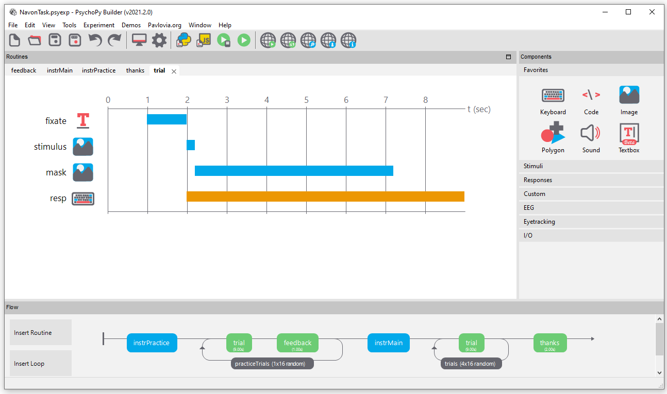
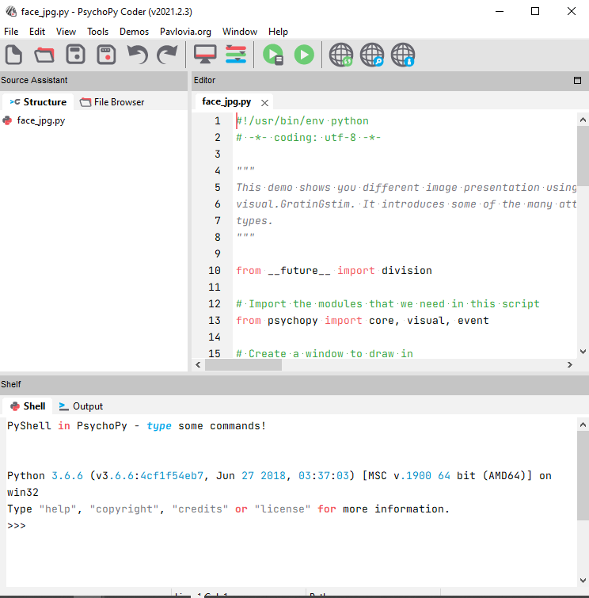
BUILD EXPERIMENT
Online!
BUILDER
CODER

Slide 8
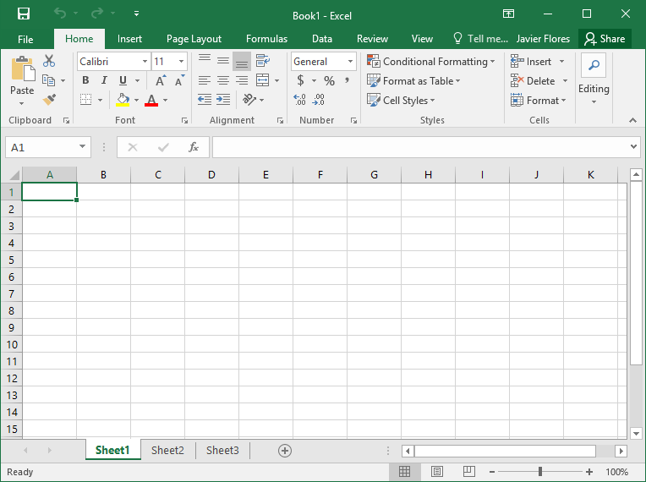
BUILD EXPERIMENT
Builder
Builder
Excel
+
LOGIC
CONDITION

Slide 9
GOAL 1
Experiment Creation Demo

Slide 10
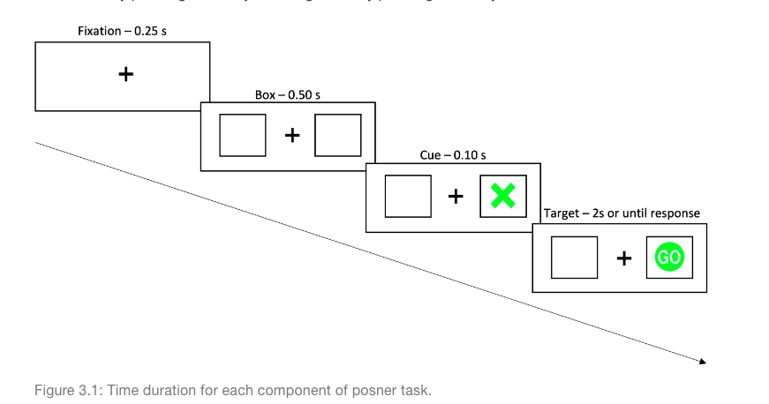
Posner Cuing Task
Participants will see a fixation cross in the middle and one box to the right and one box to the left. A cue will appear in one of the two boxes followed by a GO signal in either the same box as the cue (valid) or different place as the cue (invalid). Time duration for each segment is outlined in the picture below. Participants will be asked to decide as quickly and accurately as possible if they see the GO signal on the left box by pressing the S key or the right box by pressing the K key. There will be a total of 20 trials.

Slide 11
Posner Cuing Task
Fixation cross
  start: 0s, durations: (until end)
2 boxes
  start: 0.25s, duration: (until end)
Cue
  start: 0.75s, durations: 0.10
  GO signal
    Start: 0.85s, duration: 2s
    Response
      Start: 0.85, duration: unlimited (quit when response is made)

Slide 12
GOAL 2
Add practice trials using a code component

Slide 13
GOAL 3
Add instructions, welcome, and goodbye screen

Slide 14
You have a working experiment!

Slide 15


Online Experiment
Building
Hosting
Consent
Recruitment
PsychoPy
Pavlovia
Pavlovia Survey for online consent form
URPP
Prolific

Slide 16


Online Experiment
Building
Hosting
Consent
Recruitment
PsychoPy
Pavlovia
Pavlovia Survey for online consent form
URPP
Prolific

Slide 17
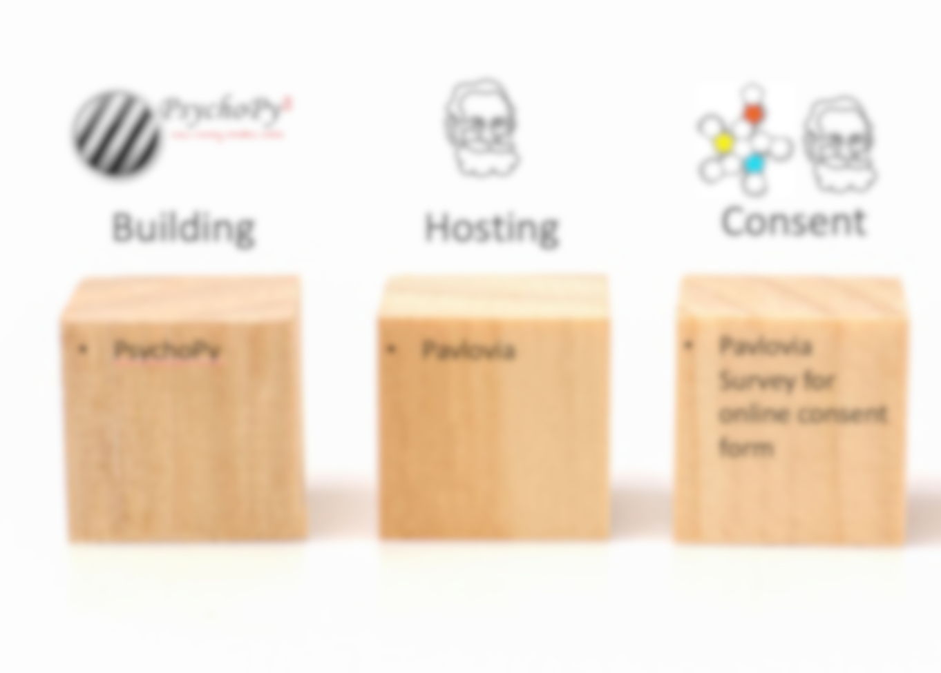
Online Experiment
Building
Hosting
Consent
Recruitment
PsychoPy
Pavlovia
Pavlovia Survey for online consent form
URPP
Prolific

Slide 18

Reach out to me: (ahsant@my.yorku.ca)
Psychopy Help Forum: https://discourse.psychopy.org/
Online Experiment: https://tasfiaahsan.github.io/Creating-Online-Experiments-with-PsychoPy/

